Slide 1
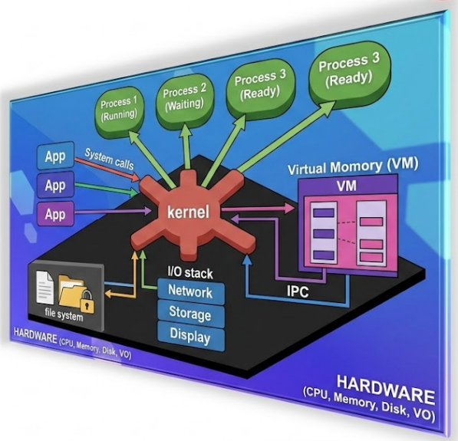
OPERATING SYSTEM
Processes-III
Spring 2026-Week 5
Contact
Islam Muhammad Zubair
mzislam@sejong.ac.kr
Office 459 AI Center
Notes:
Operating System Concepts – 10 Edition
Disclaimer
I fully acknowledge the authors of the books for providing slides and other material.

Slide 2
Outlines
Recap Last Class
Process and daemons
Hands-On Practice

Slide 3
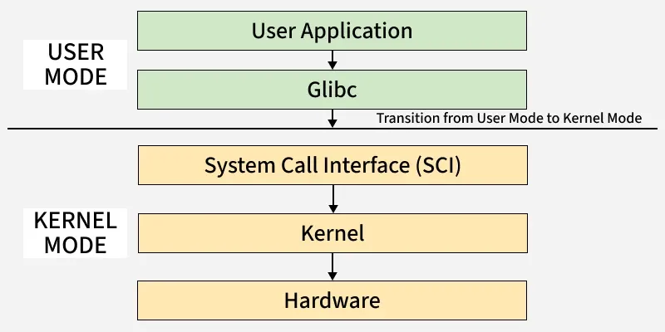
Recap: User Mode Vs Kernel Mode
A system call is the programmatic way a user-level application requests services from the operating system's kernel, acting as a secure interface to privileged resources.

Slide 4
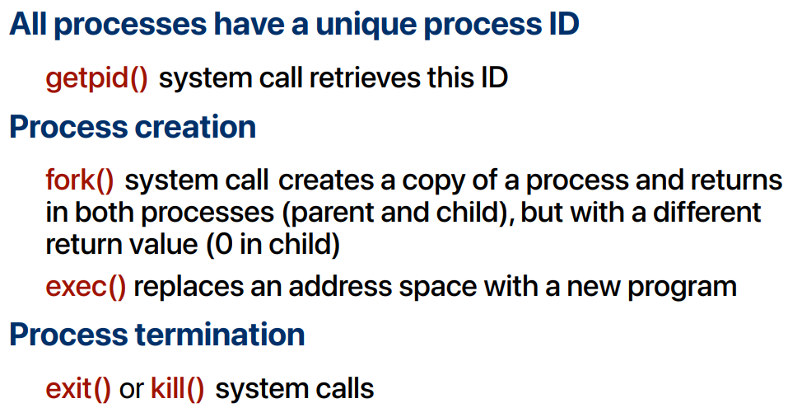
Recap: Process creation

Slide 5
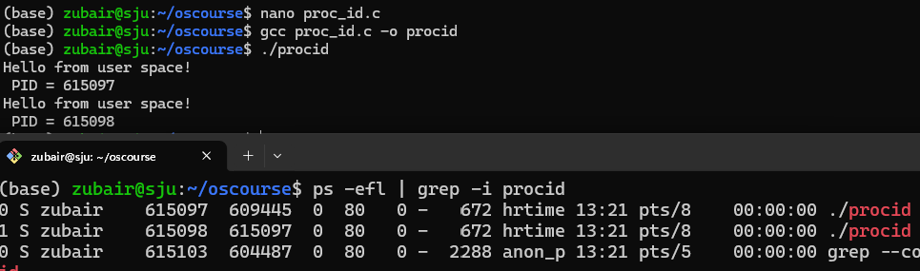
Process creation: fork()
Fork(): The fork () system call is used to create a separate, duplicate process.
// test.c
#include <stdio.h>
#include <sys/types.h>
#include <unistd.h>
int main() {
fork();
printf("Hello from user space!\n PID = %d\n“, getpid());
return 0;
}
gcc test.c -o getid_demo
./getid_demo

Slide 6
Process creation: Exec():
Exec(): when an exec() system call is invoked, the program specified in the parameter to exec() will replace the entire process
//proc1
#include <stdio.h>
#include <stdlib.h>
#include <unistd.h>
int main(int argc, char *argv[])
{
printf("PID of Proc-1 file: PID = %d\n", getpid());
char *args[]= {"Hello", "OS", "Class", NULL};
execv("./pro2", args);
printf("Back to Proc-1 file");
return 0;
}
gcc pro1.c -o pro1
./pro1

Slide 7
Process creation: Exec():
Exec(): when an exec() system call is invoked, the program specified in the parameter to exec() will replace the entire process
//proc2
#include <stdio.h>
#include <stdlib.h>
#include <unistd.h>
int main(int argc, char *argv[])
{
printf("We are in Proc2 File\n");
printf("PID of Proc2 File: PID = %d\n", getpid());
return 0;
}
gcc pro2.c -o pro2
./pro2

Slide 8

Process creation: Exec():
Exec(): when an exec() system call is invoked, the program specified in the parameter to exec() with replace the entire process

Slide 9
Process creation
#include <stdio.h>
#include <stdlib.h>
#include <unistd.h>
int main()
{
printf("hello world (pid: %d)\n", getpid());
int rc = fork();
if (rc < 0) {
fprintf(stderr, "fork failed.\n");
exit(1);
}
else if (rc == 0) {
// Child process
printf("Child: pid = %d\n", getpid());
sleep(10); // keep child alive
}
else {
// Parent process
printf("Parent: pid = %d, child pid = %d\n", getpid(), rc);
sleep(10); // keep parent alive
}
return 0;
}
gcc test.c -o fork_demo
./fork_demo
ps -ef | grep fork_demo

Slide 10
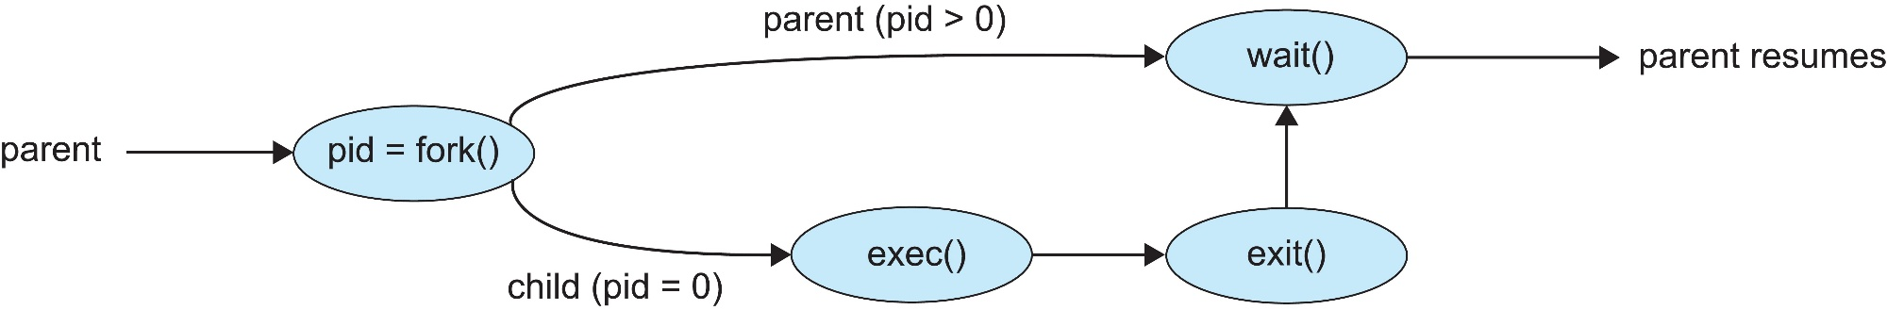
Process creation with fork()
fork() creates a new process by copying the content of the calling process’ address space
The new process has its own
address space (content is copied from parent)
Process control block in the OS

Slide 11
Process creation
Process: A process is a program in execution. When we write source code in C or C++ and compile it, the compiler generates an executable binary file. This executable file is called a program. When the program is loaded into memory and executed, it becomes a process
Daemon: A daemon process is a background process that runs independently of any user control and performs specific tasks for the system. Daemons are usually started when the system starts, and they run until the system stops.

Slide 12
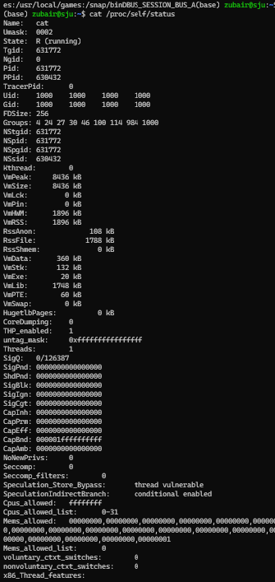
Process Details
cat /proc/self/status
cat /proc/self/stat
cat /proc/self/comm
cat /proc/self/limits
cat /proc/self/environ

Slide 13

Process PID
Get PROCES ID
echo $$ : Show process ID of current terminal
ps -ef | less : Show less
ps -ef | wc –l : Count
pidof firefox : Show process ID
KILL Process
kill <PID>
kill firefox
kill firefox
Kill -9 <PID>
Forcefully kill process
Class Practice:
firefox –headless : run in one terminal
ps -ef | grep -i firefox : run in second terminal
Task:
Get process ID and kill the process using command learn above

Slide 14
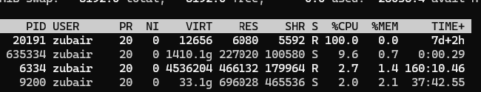
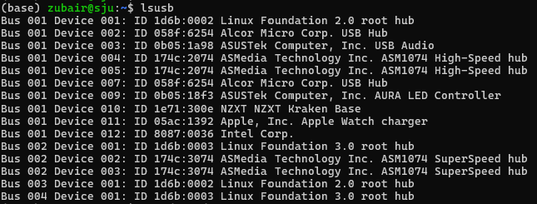
Process In-Depth
top: It is similar to task manager in window
cat /proc/cpuinfo: CPU Info
lscpu: same as above
cat /proc/meminfo: memory information
lsusb: usb information
pstree | less : Show process tree
pstree | grep -i fire
top –n1 > ./top.txt
Notes:
top , htop, sar , vmstat , free –m, ps –el , ps –ef,

Slide 15
Daemons
Daemon mean Process running in background
Daemon mean services in linux
Daemons:
Application
System
If you kill application daemon it will not effect on system if you kill system daemon it will crash the system
Interview: What are Performance Monitoring Tool used in Linux

Slide 16
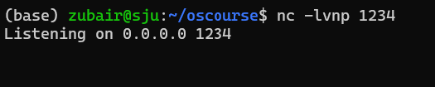


Daemons
nc -lvnp 1234
nc -lvnp 1234 & : Run the programme in background

Slide 17
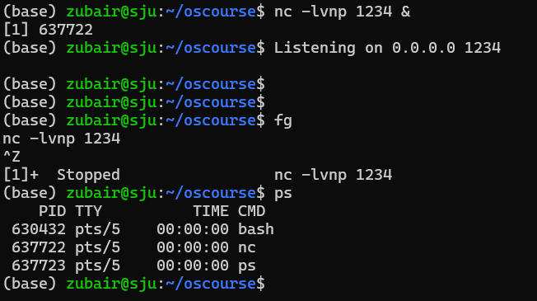
Daemons

Slide 18
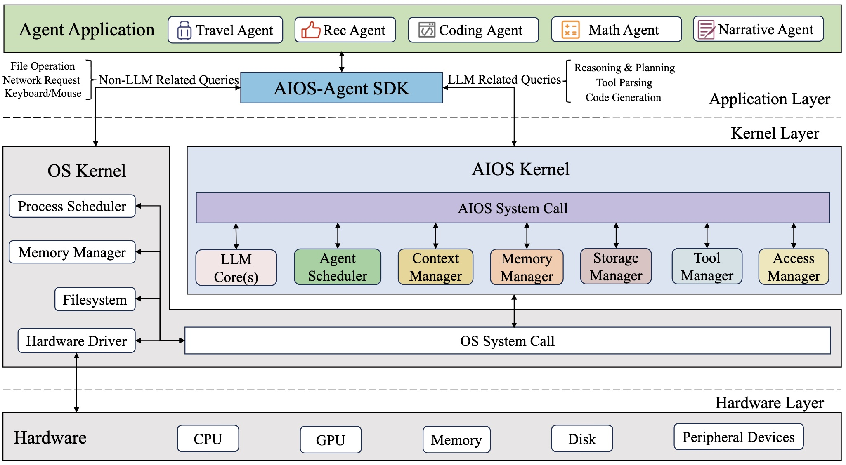
Agentic OS
https://github.com/agiresearch/AIOS
https://docs.aios.foundation/aios-docs

Slide 19
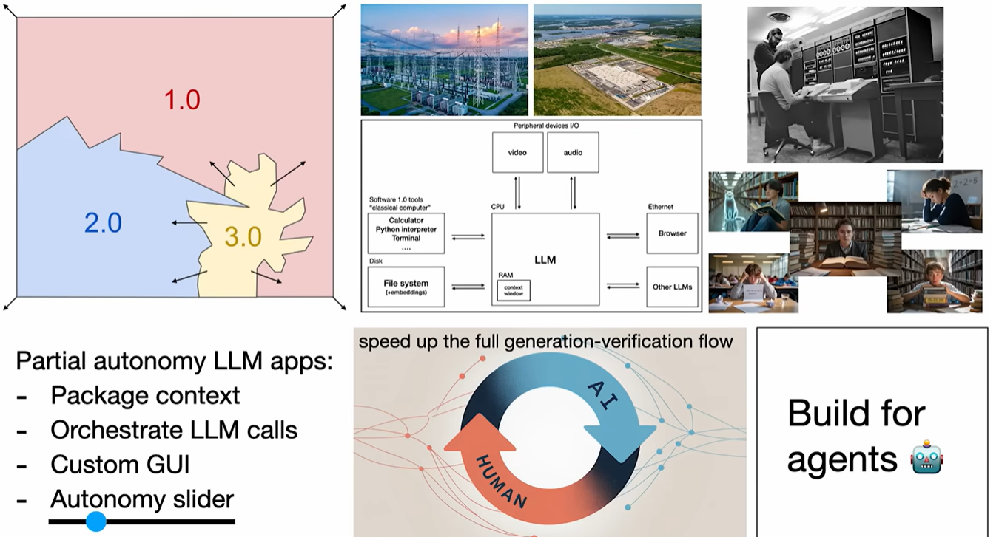
Software is changing Again
Andrej Karpathy: LLM = OS
https://www.youtube.com/watch?v=LCEmiRjPEtQ&t=664s

Slide 20


